Slide 1
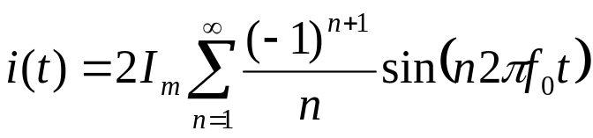


Sawtooth waveform
Java Applet: www.falstad.com/fourier/ (turn on sound)

